Slide 1
Face Mask Detection
Name = Shubham Rana
Semester = 6
Section -A
Unversity Rno = 1018466
Class Rno = 65

Slide 2
OpenCV
OpenCV (Open Source Computer Vision Library) is an open source computer vision and machine learning software library. OpenCV was built to provide a common infrastructure for computer vision applications and to accelerate the use of machine perception in the commercial products. Being a BSD-licensed product, OpenCV makes it easy for businesses to utilize and modify the code.

Slide 3
The library has more than 2500 optimized algorithms, which includes a comprehensive set of both classic and state-of-the-art computer vision and machine learning algorithms. These algorithms can be used to detect and recognize faces, identify objects, classify human actions in videos, track camera movements, track moving objects, extract 3D models of objects, produce 3D point clouds from stereo cameras, stitch images together to produce a high resolution image of an entire scene, find similar images from an image database, remove red eyes from images taken using flash, follow eye movements, recognize scenery and establish markers to overlay it with augmented reality, etc. OpenCV has more than 47 thousand people of user community and estimated number of downloads exceeding 18 million. The library is used extensively in companies, research groups and by governmental bodies.

Slide 4
It has C++, Python, Java and MATLAB interfaces and supports Windows, Linux, Android and Mac OS. OpenCV leans mostly towards real-time vision applications and takes advantage of MMX and SSE instructions when available. A full-featured CUDAand OpenCL interfaces are being actively developed right now. There are over 500 algorithms and about 10 times as many functions that compose or support those algorithms. OpenCV is written natively in C++ and has a templated interface that works seamlessly with STL containers.

Slide 5
Matplotlib
matplotlib is a Python library that allows Python to be used like Matlab, visualizing data on the fly. It is able to create plots, histograms, power spectra, bar charts, errorcharts, scatterplots, etc. It can be used from normal Python and also from iPython.
Examples:
Plot a data series that represents the square function:
from matplotlib import pyplot as plt
data = [x * x for x in range(20)]
plt.plot(data)
plt.show()

Slide 6
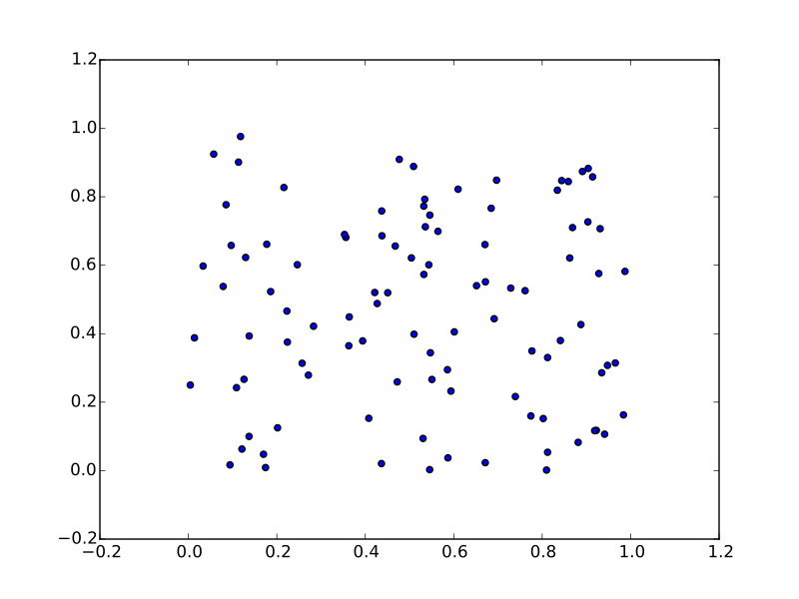
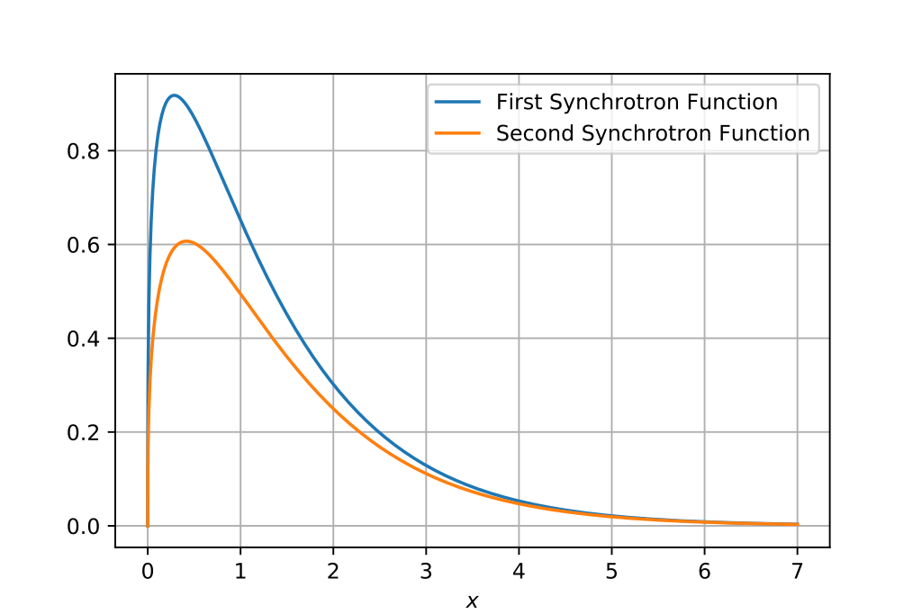
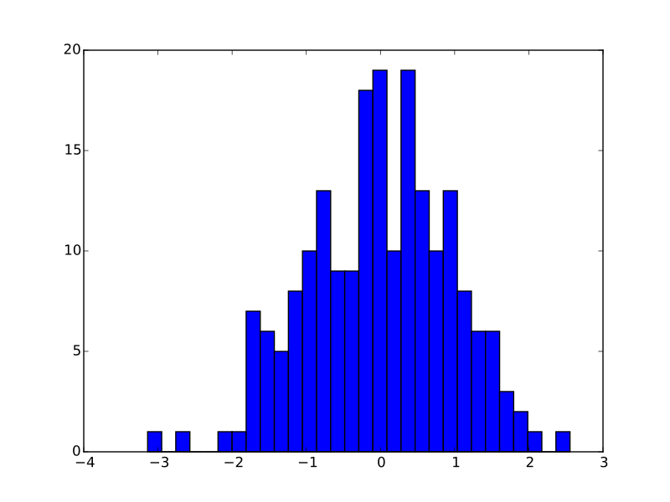

Slide 7
Face and eye detection
Object Detection using Haar feature-based cascade classifiers is an effective object detection method proposed by Paul Viola and Michael Jones in their paper, "Rapid Object Detection using a Boosted Cascade of Simple Features" in 2001. It is a machine learning based approach where a cascade function is trained from a lot of positive and negative images. It is then used to detect objects in other images.
Here we will work with face detection. Initially, the algorithm needs a lot of positive images (images of faces) and negative images (images without faces) to train the classifier. Then we need to extract features from it. For this, Haar features shown in the below image are used. They are just like our convolutional kernel. Each feature is a single value obtained by subtracting sum of pixels under the white rectangle from sum of pixels under the black rectangle.

Slide 8
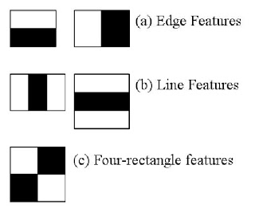

Slide 9
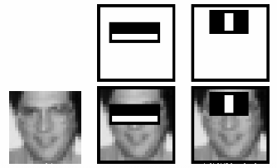

Slide 10
Training Data (With and WithoutMask)
data = []
while True:
flag, img = vc.read()
if (flag ):
faces = frontFaceData.detectMultiScale(img)
faces = frontFaceData.detectMultiScale(img)
for x,y,w,h in faces:
cv2.rectangle(img, (x,y), (x + w, y + h), (255,0,255 ), 4)
face = img[y:y+h, x: x + w, :]
face = cv2.resize(face, (50,50))

Slide 11
print (len(data))
if (len(data) < 400):
data.append(face)
cv2.imshow('result',img)
if cv2.waitKey(2) == 27 or len(data) >= 200:
break
vc.release()
cv2.destroyAllWindows()

Slide 12
Load Training Data
withMask = np.load('withMask.npy')
withoutMask = np.load('withoutMask.npy')

Slide 13
Sklearn
Scikit-learn (Sklearn) is the most useful and robust library for machine learning in Python. It provides a selection of efficient tools for machine learning and statistical modeling including classification, regression, clustering and dimensionality reduction via a consistence interface in Python. This library, which is largely written in Python, is built upon NumPy, SciPy and Matplotlib.

Slide 14
SVM
Support vector machines (SVMs) are a set of supervised learning methods used for classification, regression and outliers detection.
The advantages of support vector machines are:
Effective in high dimensional spaces.
Still effective in cases where number of dimensions is greater than the number of samples.
Uses a subset of training points in the decision function (called support vectors), so it is also memory efficient.
Versatile: different Kernel functions can be specified for the decision function. Common kernels are provided, but it is also possible to specify custom kernels.

Slide 15
Code for Live face mask detection using webcam
frontFaceData = cv2.CascadeClassifier('data.xml')
vc = cv2.VideoCapture(0)
data = []
font = cv2.FONT_HERSHEY_COMPLEX
while True:
flag, img = vc.read()
if (flag ):
faces = frontFaceData.detectMultiScale(img)
faces = frontFaceData.detectMultiScale(img)
for x,y,w,h in faces:
cv2.rectangle(img, (x,y), (x + w, y + h), (255,0,255 ), 4)

Slide 16
face = img[y:y+h, x: x + w, :]
face = cv2.resize(face, (50,50))
face = face.reshape(1,-1)
face = pca.transform(face)
pred = svm.predict(face)[0]
n = names[int(pred)]
cv2.putText(img, n, (x,y),font ,1, (244,250,250),2)
print(n)
cv2.imshow('result',img)
if cv2.waitKey(2) == 27 :
break
vc.release()
cv2.destroyAllWindows()

